Slide 1

GURU NANAK INSTITUTE OF TECHNOLOGY
Department Of Computer Science and Engineering
REAL-TIME AUDIO EVENT DETECTION FOR THREAT IDENTIFICATION USING CNN
UNDER THE GUIDANCE OF
Mrs. P. Anusha
Assistant Professor-CSE
TEAM MEMBERS
K.NIKHIL SARADHI – 21831A0587
K.SRAVAN KUMAR - 21831A0590
M.TEJESH - 21831A05B0

Slide 2
ABSTRACT
This project aims to detect potential threats in real time using audio event recognition. Audio events like gunshots, screams, and glass breaking are analyzed to identify security threats. A 1D Convolutional Neural Network (1D CNN) is used to classify these sounds effectively. The model processes audio waveforms directly without complex preprocessing. The system offers fast and accurate threat detection suitable for surveillance applications.

Slide 3
OBJECTIVES
To develop an intelligent system that detects threatening audio events in real time.
To improve accuracy and response time compared to existing models.
To reduce false positives using a lightweight 1D CNN architecture.
To ensure low-latency predictions for integration in security systems.
To build a scalable and deployable solution for public safety monitoring.

Slide 4
INTRODUCTION
Security threats in public and private spaces often begin with distinct sound events. Early detection through audio surveillance can prevent harm and alert authorities instantly. Traditional systems depend on manual monitoring or rule-based logic. With advancements in deep learning, automated audio recognition has become feasible. This project explores the use of 1D CNNs for effective threat detection from raw audio data.

Slide 5
LITERATURE SURVEY
S.No | Title Of the project | Description
1. | Infrared Environmental sound classification based on improved compact bilinear attention network | The authors tackle the common limitations of traditional sound classification methods by proposing an enhanced deep learning model that uses a compact bilinear attention mechanism. This attention-based approach helps the model better focus on the most relevant parts of an audio signal.
2. | Deep learning based source identification of environmental audio signals using optimized convolutional neural networks | The proposed approach demonstrates strong capabilities in distinguishing between a variety of sound sources, such as animal calls or mechanical noises, even under noisy or variable conditions. These improvements are particularly valuable for real-time monitoring applications, like wildlife tracking or urban sound surveillance.
.

Slide 6
EXISTING SYSTEM
LSTM AND CNN:
Previous approaches combine LSTM with CNN to capture both spatial and temporal features. CNNs extract sound features, while LSTMs model the sequential nature of audio signals. Though effective, these systems are complex and computationally expensive. They require more processing power and longer training time. Such systems may not be ideal for real-time applications with limited resources.

Slide 7
PROPOSED SYSTEM
1D CNN:
The proposed system uses a 1D CNN to directly process audio signals for threat identification. It simplifies the architecture by eliminating recurrent layers like LSTM. This leads to faster training and real-time predictions with reduced hardware requirements. The model efficiently learns patterns from waveform data to classify events. It balances performance, accuracy, and computational efficiency.

Slide 8
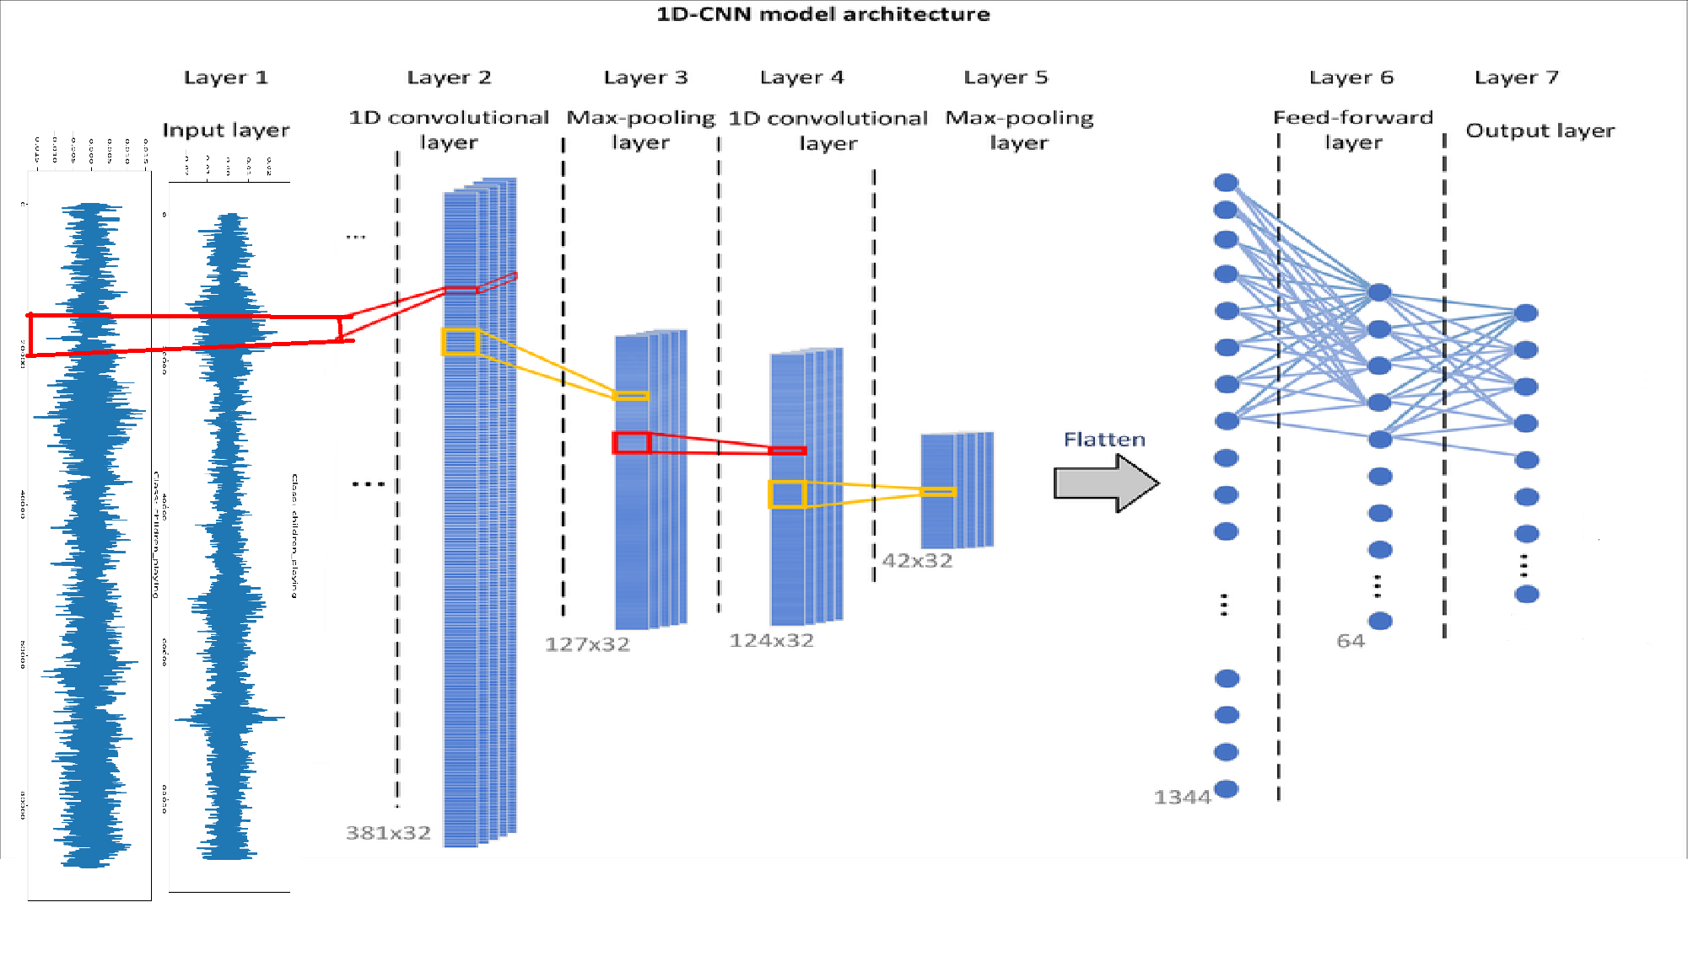
SYSTEM ARCHITECTURE

Slide 9
DATA FLOW DIAGRAM
Data Collection
Data Sources
Data Preprocessing
NLP System
Trained Model
Model Training
Prediction Results
prediction

Slide 10
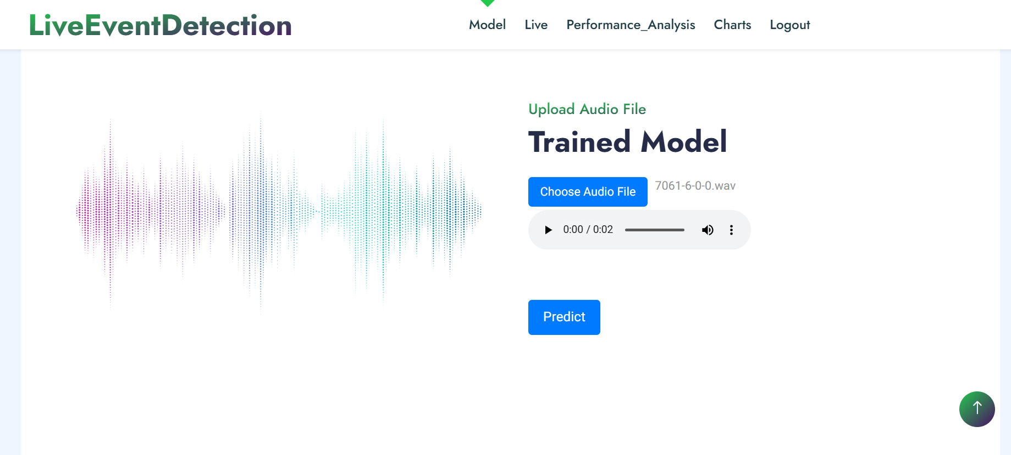
RESULTS AND DISCUSSION
Input Page

Slide 11
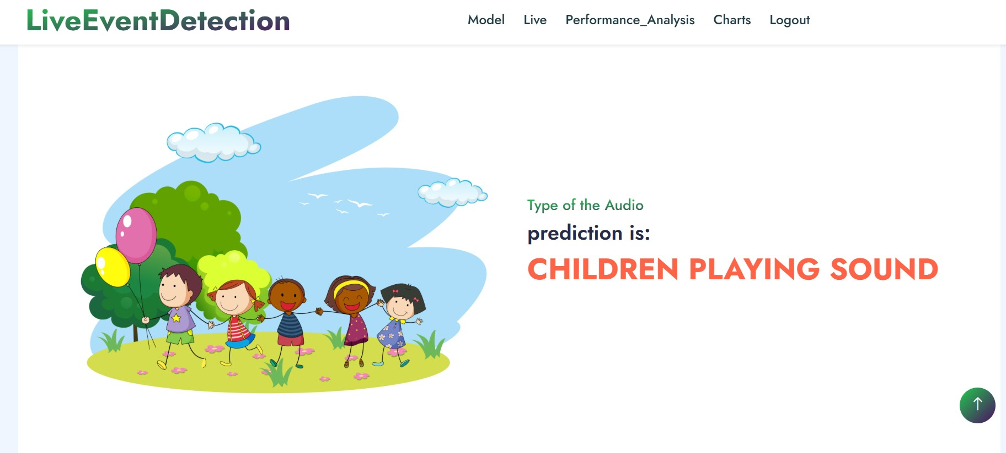
Output Page

Slide 12
CONCLUSION AND FUTURE ENHANCEMENT
The 1D CNN-based audio event detection system offers real-time threat identification with improved speed and simplicity. It shows promising results in recognizing critical sounds in dynamic environments. In future, the system can be enhanced with multi-class classification and multilingual audio support. Integration with video surveillance can provide better situational awareness. Deployment on edge devices can further increase its real-world utility.

Slide 13
REFERENCES
G. Ciaburro and G. Iannace, ‘‘Improving smart cities safety using sound events detection based on deep neural network algorithms,’’ Informatics, vol. 7, no. 3, p. 23, Jul. 2024.
D. D. Nguyen, M. S. Dao, and T. V. T. Nguyen, ‘‘Natural language processing for social event classification,’’ in Knowledge and Systems Engineering. Cham, Switzerland: Springer, 2023, pp. 79–91.
A. Hodorog, I. Petri, and Y. Rezgui, ‘‘Machine learning and natural lan_x0002_guage processing of social media data for event detection in smart cities,’’ Sustain. Cities Soc., vol. 85, Oct. 2023, Art. no. 104026.
Q. Kong, Y. Cao, T. Iqbal, Y. Wang, W. Wang, and M. D. Plumbley, ‘‘PANNs: Large-scale pretrained audio neural networks for audio pat_x0002_tern recognition,’’ IEEE/ACM Trans. Audio, Speech, Language Process., vol. 28, pp. 2880–2894, 2022.

